Slide 1


Variables Selection – Forward Direction Search
Here we only give results from BIC:
BODYFAT ~ ABDOMEN + WEIGHT + WRIST BIC=700.41
BODYFAT ~ LogABDOMEN + LogWRIST + LogHEIGHT BIC=697.82
BODYFAT ~ sqABDOMEN + sqWEIGHT + sqWRIST BIC=705.87
BODYFAT ~ ABDOMEN + sqWEIGHT + LogWRIST BIC=697.68
BIC will give simpler models than AIC.
ABDOMEN and its transformation is also the most important variable, followed by WEIGHT and WRIST.

Slide 2
Variables Selection – Summary
12 alternative models:
BODYFAT ~ ABDOMEN + sqWEIGHT + LogWRIST
BODYFAT ~ LogWRIST + sqHEIGHT + LogABDOMEN
BODYFAT ~ ABDOMEN + sqWEIGHT
BODYFAT ~ sqABDOMEN + sqWEIGHT + sqWRIST
BODYFAT ~ sqABDOMEN + sqWEIGHT
BODYFAT ~ sqABDOMEN
BODYFAT ~ LogABDOMEN + LogWRIST + LogHEIGHT
BODYFAT ~ LogABDOMEN + LogWRIST
BODYFAT ~ LogABDOMEN
BODYFAT ~ ABDOMEN + WEIGHT + WRIST
BODYFAT ~ ABDOMEN + WEIGHT
BODYFAT ~ ABDOMEN

Slide 3
Model Selection 30 - Repeated with 10 - fold Cross Validation The root mean squared error and R-squared of 12 models:
ID | Model | Root Mean Squared Error | R-squared
1 | BODYFAT ~ ABDOMEN + sqWEIGHT + LogWRIST | 3.937862 | 0.7247008
2 | BODYFAT ~ LogWRIST + sqHEIGHT + LogABDOMEN | 3.941071 | 0.7226578
3 | BODYFAT ~ ABDOMEN + sqWEIGHT | 4.001342 | 0.7149690
4 | BODYFAT ~ sqABDOMEN + sqWEIGHT + sqWRIST | 4.000357 | 0.7161659
5 | BODYFAT ~ sqABDOMEN + sqWEIGHT | 4.040667 | 0.7083916
6 | BODYFAT ~ sqABDOMEN | 4.322792 | 0.6614911
7 | BODYFAT ~ LogABDOMEN + LogWRIST + LogHEIGHT | 3.945733 | 0.7225947
8 | BODYFAT ~ LogABDOMEN + LogWRIST | 4.030833 | 0.7094928
9 | BODYFAT ~ LogABDOMEN | 4.287261 | 0.6685336
10 | BODYFAT ~ ABDOMEN + WEIGHT + WRIST | 3.965277 | 0.7230111
11 | BODYFAT ~ ABDOMEN + WEIGHT | 4.024765 | 0.7136045
12 | BODYFAT ~ ABDOMEN | 4.289724 | 0.6674128

Slide 4

Model Diagnosis and Summary
We choose ABDOMEN, WEIGHT as our predictors.
Final model
BODYFAT(%)=0.89 ABDOMEN-0.12 WEIGHT-42.4.
Rule of thumb: BODYFAT(%)=abdomen circumference(cm)*0.89 minus weight(lbs)*0.12 minus 42.4.
Adjusted R squared is 0.7029.
Residual standard error is 4.03.
All variables are significant.
No serious multicollinearity, mean VIF=4.0.
Example: Man with 154 lbs WEIGHT and 85 cm ABDOMEN, his BODYFAT will be 15(%).
Coefficients | Estimate | Std Error | P-value | 95% CI Lwr | 95% CI Upr
Intercept | -42.39 | 2.54 | < 2e-16 | -47.399 | -37.383
ABDOMEN | 0.89 | 0.053 | < 2e-16 | 0.789 | 0.997
WEIGHT | -0.12 | 0.019 | 5e-09 | -0.158 | -0.0802

Slide 5
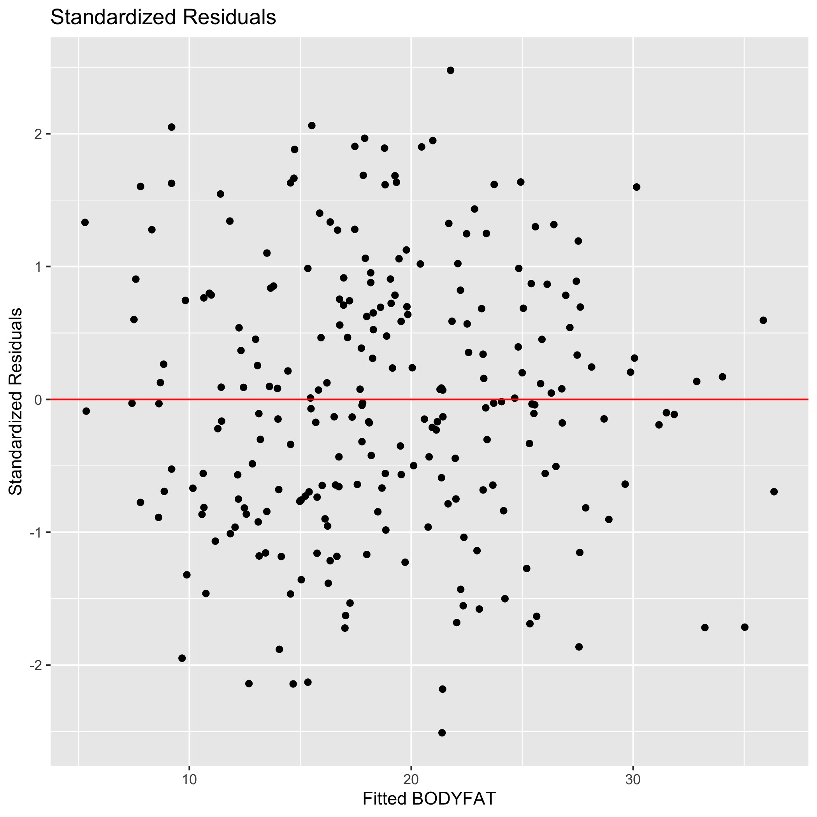
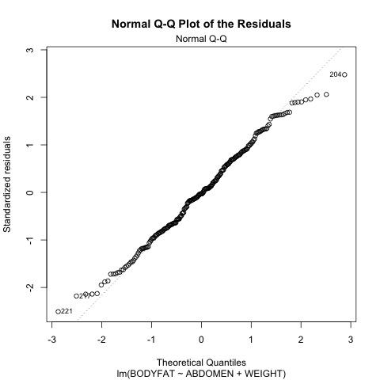
Model Diagnosis – Standardized Residuals, QQ plots for Residuals

Slide 6
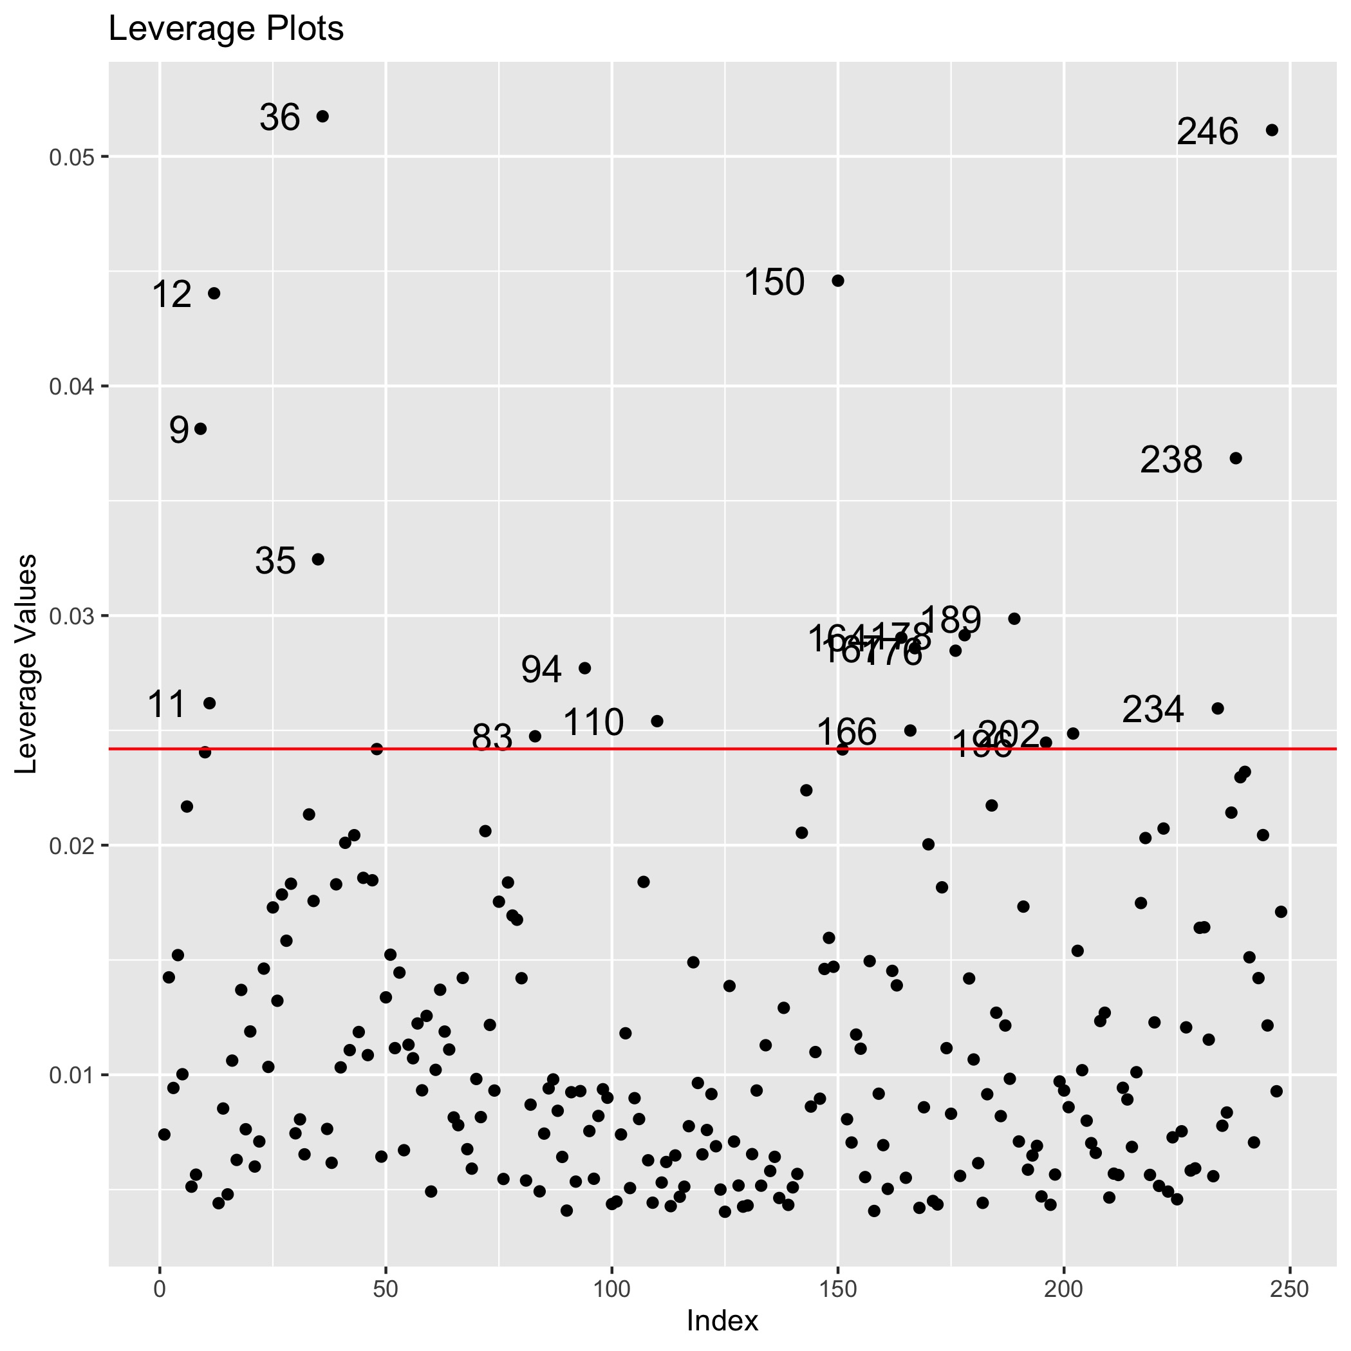
Model Diagnosis – Leverage Plots
The leverage is diagonal elements from 𝐻=𝑋(𝑋′𝑋)⁻¹𝑋′
There is a lot of outliers in Leverage plots.
But the coefficients of model change little after removing the outliers and fitting again.
The new model without outliers is BODYFAT(%)=0.88 ABDOMEN-0.11 WEIGHT-43.14
So we keep the initial model .

